Slide 1





final project
Connect Four
group 17
章顺杰，罗天辰

Slide 2
Contents
01
introduction
02
formulation
Gaming Background
Description of this game
Solution ideas &
comparative experiments
Results &
Contributions
03
04
The Algorithm To Solve This Problem
Summary this project

Slide 3
part one
introduction of Connect 4

Slide 4
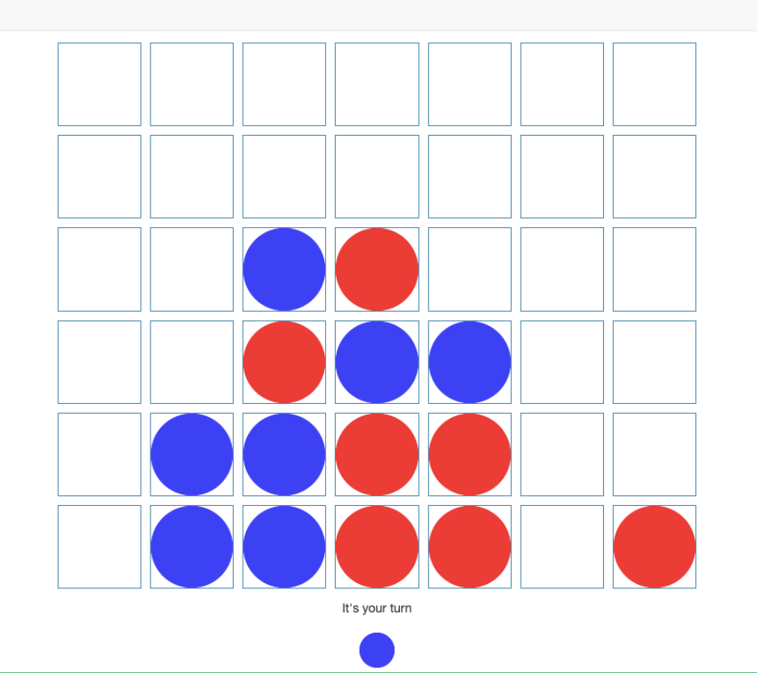
introduction of Connect 4
HOW TO PLAY IT
Connect Four is a classic two-player strategy game played on a vertical 6-row by 7-column grid. Players take turns dropping black and white discs into columns, with pieces falling to the lowest empty space in that column. The goal is to be the first to form a consecutive line of four of one's own discs—vertically, horizontally, or diagonally. Players must block opponents' potential lines while advancing their own strategy. If the board fills completely without a four-in-a-row, the game will be decided by comparing the number of three-in-a-row sequences each player has, with a draw occurring if counts are equal.
Notes:
四连棋是一款经典的两人策略游戏，在一个垂直的6行7列的棋盘上进行。玩家轮流将黑白棋子放入棋盘列中，棋子会下落至该列最低的空位。游戏目标是通过在垂直、水平或对角线方向上连续排列四个己方棋子，率先达成四连。玩家在推进自身策略的同时，必须阻截对手的连珠企图。若棋盘完全填满却未形成四连，游戏将根据玩家三联棋子个数大小评估获胜玩家，若三连棋子对数相同则平局。

Slide 5
part two
formulation

Slide 6
formulation
discription of this game
State: A 6×7 matrix with values {−1, 0, +1} representing player discs and empty slots.
Action Space: 7 discrete actions (column choices).
Reward: +1 for a win, −1 for a loss, 0 otherwise.
This formulation enables algorithmic implementations ranging from rule-based agents to deep reinforcement learning.
Terminal State ：
Win: Occurs if a player forms a consecutive line of four discs horizontally, vertically, or diagonally.
Draw: Occurs only when the board is completely filled with no four-in-a-row and both players have an equal number of three-in-a-row sequences.
(If the board is full with no four-in-a-row but unequal three-in-a-row counts, the player with more three-in-a-row sequences wins.)

Slide 7
part three
Solution ideas and
comparative experiments

Slide 8
Solution ideas
Random Policy
Greedy Algorithm
Minimax
Q-learning (DQN)
The random policy selects moves uniformly from legal columns, offering no strategic advantage.
This heuristic-based approach prioritizes immediate gains (e.g., completing a 3-in-a-row) or blocking opponents.
Combining Minimax search with pruning, it evaluates future moves up to a fixed depth (e.g., 4 layers).
A reinforcement learning method training a neural network to predict optimal moves.

Slide 9
Greedy Algorithm
Check if any column yields a winning four-in-a-row for the AI, or blocks an opponent’s imminent win. If no decisive moves exist, evaluate options via heuristic scoring. Reward central columns (e.g., column 3) for strategic flexibility, award points for open three-in-a-row patterns or double connections, and penalize moves allowing future opponent wins.
Notes:
1. 游戏建模与合法移动生成
Connect4棋盘为6行×7列的垂直网格，棋子受重力影响落在列底部。AI需首先生成所有合法移动，即未填满的列编号（0-6）。
2. 即时胜负判断
优先级1：检查AI当前能否通过某列落子直接形成四连。使用函数模拟在落子后是否胜利，若有则立即选择该列。
优先级2：检查对手下一步是否存在必胜机会。遍历所有列，模拟对手落子后是否获胜，若存在则必须拦截。
3. 启发式评估函数
当无即时胜负时，需设计评估函数量化每个移动的价值：
连珠潜力：分析在落子后，AI形成的潜在链条。
例如：
开放三连未被阻挡，价值高于被阻挡的
中心优势：中间列提供更多连接方向，给予基础加分（如+30）
威胁预防：若某移动可能导致对手下一轮必胜，需扣除威胁分（如-200）
示例评分权重：
立即胜利 +1000
阻止对手胜利 +500
开放三连 +100
双连 +50
中心位置 +30
4. 模拟落子与评分
对每个合法列c：
a) 创建棋盘副本，模拟AI落子
b) 调用评估函数计算score
c) 记录最高分及其对应列
5. 决策与打破平局
选择最高对应的列。

Slide 10
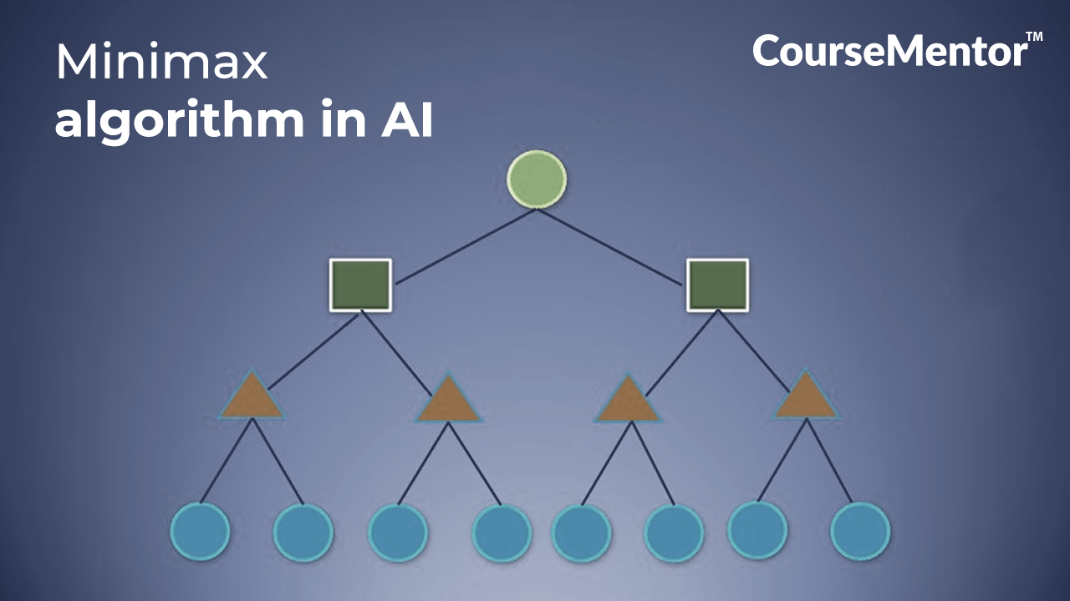
Minimax + MCT
Use the UCT algorithm to balance exploration (under-explored paths) and exploitation (high-reward paths). When reaching a leaf node, if the game isn’t terminal, perform a limited-depth Minimax evaluation (e.g., 3-4 layers) to expand child nodes, prioritizing critical positions.
Propagate the evaluation results (win/loss probabilities and Minimax scores) back up the tree, updating node statistics to refine future decisions.
Notes:
1. 树结构构建: 创建蒙特卡洛树，节点代表棋盘状态，边为合法移动。每个节点存储访问次数、胜率及Minimax评估值。
2. 选择与扩展: 使用UCT算法平衡探索和利用exploitation，选择有潜力的节点。到达叶节点时，若未达终止状态，用Minimax进行深度有限评估(e.g., 3-4层)，生成子节点。
3. 模拟与评估: 对扩展节点，此处利用Minimax启发式评估（带alpha-beta剪枝）计算该状态得分，避免低效随机模拟。
4. 回溯更新: 将评估结果反向更新路径上的节点数据，调整胜率和Minimax值权重。
5. 决策: 经过预定迭代次数后，选择访问次数最多或Minimax得分最高的列。

Slide 11
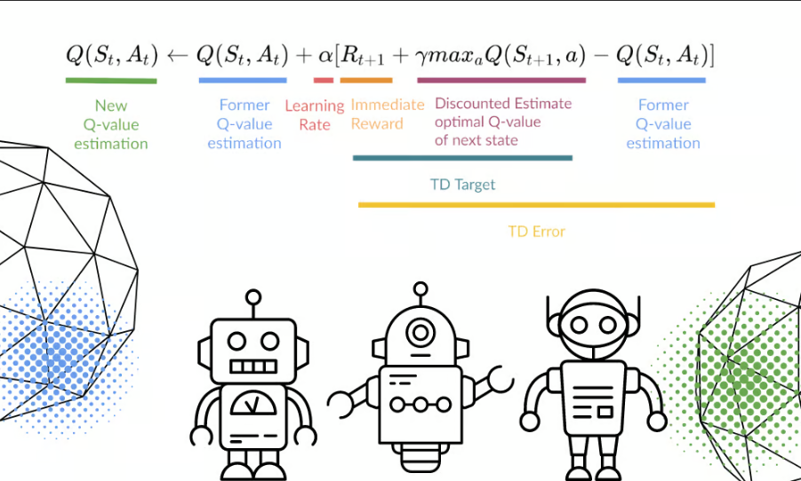
Q-learning
In the training loop, run multiple episodes where the AI uses an epsilon-greedy policy to balance exploration (random column selection with probability ε) and exploitation (choosing the column with the highest Q-value). After executing an action, observe the new state and reward, then update the Q-value using the formula:
Q(s,a) += α [R + γ*max(Q(s',a')) - Q(s,a)].
The opponent responds with a predefined strategy (e.g., random moves or rule-based AI).
Notes:
1. 环境建模: 将棋盘状态编码为state（如6×7矩阵，标记玩家与对手棋子），动作空间为列数（0-6）。仅允许合法移动（未满列）。
2. Q表初始化: 创建Q-table存储每个state-action对的预期奖励值，初始为0或随机值。设置学习率α（如0.1）、折扣因子γ（如0.9）及探索率ε（如初始0.3，逐步衰减）。
3. 奖励设计: 定义奖励规则——胜利+100，失败-100，平局0；中间奖励如形成三连+10，阻止对手+20，以引导策略学习。
4. 训练循环: 运行多轮episode，每轮中：
使用ε-greedy策略选择动作：以ε概率随机探索，否则选当前状态最大Q值的列。
执行动作后，观察新状态(new state)和奖励，按Q更新公式调整Q值：
Q(s,a) += α [R + γ*max(Q(s',a')) - Q(s,a)]
对手回合使用预定义策略（如随机或规则AI）响应。
5. 状态抽象优化: 应对状态爆炸问题，使用特征提取——如统计中心区域控制、开放三连数量等，替代完整棋盘编码。
6. 策略部署: 训练完成后，AI选择当前状态Q值最高的动作进行对战。
因为Q-table难以覆盖所有状态，需结合神经网络升级为DQN或优先经验回放提升效率。

Slide 12



comparative experiments
AI vs AI
Let our AI agent compete with other existing AI agents, and calculate the winning rate.
AI vs Human
Fewer steps
Play with the AI agent and calculate the winning rate within the limited period of time.
See if our AI agent can beat us in fewer steps than other AI agent.

Slide 13
Adding more rules
According to some existing experiments on the ConnectFour game, there exists some strategy that will definitely if the board is small, while it’s easy to draw if the board is large, which is not fit for training AI.
Calculate connected components
Team combat
Instead of only judging on whether there is a connect four, we can count other connected components, such as ConnectThree , and re-evaluate the outcomes.
Let 4 agents participate in the game and each 2 of them can be viewed as a team. The final score is the sum of scores of each member, and the team with higher score wins.
Notes:
根据现有关于四连棋（ConnectFour）的实验研究表明：当棋盘较小时存在必胜策略，而棋盘过大时极易出现平局，这种情况不利于AI训练。
改进方案：
连通分量计算
不再仅判断是否达成四连，而是统计其他连通分量（如三连）并重新评估结果价值。
团队对抗模式
让4个智能体参与游戏，每两个智能体组成一队。最终得分为各队员得分之和，总分更高的队伍获胜。

Slide 14
part four
Core Project Contributions

Slide 15

Core Project Contributions
The existing AI algorithm is mainly minimax algorithm focusing on the 6 * 7 board game, which has already trained out a literally smartest AI, While this may not be as efficient when facing a larger game board. Our project tries to find out whether other methods can achieve an unexpected outcomes in a larger game board with different rules and more players.
Notes:
核心项目贡献
现有AI算法主要采用针对6*7棋盘游戏设计的minimax算法，已训练出理论上的最强AI，但在面对更大棋盘时可能效率不足。本项目旨在探究其他方法能否在更大棋盘、不同规则及更多玩家参与的情况下实现突破性表现。

Slide 16
Thank you
QUESTION & ANSWER
group 17
章顺杰，罗天辰

